Slide 1
SQL Server Query Execution and Plans
Module 5

Slide 2
Learning Units covered in this Module
Lesson 1: SQL Server Query Execution
Lesson 2: SQL Server Query Plan Analysis
Lesson 3: SQL Server Query Plan Analysis
Lesson 4: Troubleshooting with Query Store
Notes:
The SQL Server Query Optimizer is a cost-based optimizer. Each possible execution plan has an associated cost in terms of the amount of computing resources used. The Query Optimizer must analyze the possible plans and choose the one with the lowest estimated cost. Some complex SELECT statements have thousands of possible execution plans. In these cases, the Query Optimizer does not analyze all possible combinations. Instead, it uses complex algorithms to find an execution plan that has a cost reasonably close to the minimum possible cost.
The SQL Server Query Optimizer does not choose only the execution plan with the lowest resource cost; it chooses the plan that returns results to the user with a reasonable cost in resources and that returns the results the fastest. For example, processing a query in parallel typically uses more resources than processing it serially, but completes the query faster. The SQL Server Query Optimizer will use a parallel execution plan to return results if the load on the server will not be adversely affected.
The SQL Server Query Optimizer relies on distribution statistics when it estimates the resource costs of different methods for extracting information from a table or index.
The SQL Server Query Optimizer is important because it enables the database server to adjust dynamically to changing conditions in the database without requiring input from a programmer or database administrator. This enables programmers to focus on describing the final result of the query. They can trust that the SQL Server Query Optimizer will build an efficient execution plan for the state of the database every time the statement is run.
Trivial plan optimization
If SQL Server knows that there is only one viable plan for a query, a lot of work can be avoided. For example, where there is only one possible plan:
A query that consists of an INSERT with a VALUES clause.
A SELECT statement for which all the columns are among the keys of a unique composite index, and that index is the only one that is relevant. No other index has that set of columns in it.
The trivial plan query optimizer finds the really obvious plans that are typically very inexpensive. This saves the query optimizer from having to consider every possible plan, which can be costly and can outweigh any benefit provided by well-optimized queries.
Simplification
If there is no trivial plan, SQL Server will perform a simplification. These are usually syntactic transformations of the query itself, to look for commutative properties and operations that can be rearranged. There is no cost or available index analysis. SQL Server then loads up the metadata, including the statistical information on the indexes.
Cost-based optimization
A set of transformation rules is followed that apply various permutations of data access strategies, join orders, aggregation placement, subquery transformations, and other rules that guarantee that a correct result is returned.
Optimization is broken up into three search phases to prevent the process from taking much longer than the execution of the query.
SQL Server evaluates the cost of the cheapest plan after each phase and executes that plan, if the plan is cheap enough. Otherwise, the query optimizer runs the next phase, which involves another set of usually more complex rules.
Phase 0 – Transactional Processing Phase: Contains a very limited set of rules and is applied only to simple queries with three or fewer tables. A limited number of join orders are evaluated, which may generate many potential plan candidates. Hash and nested loop join strategies are considered. If a plan with an estimated cost below 0.2 is found, the optimization ends and the query is executed. This phase is also known as the Transaction Processing phase, because query plans produced by this phase are typically found for queries in online transaction processing (OLTP) applications.
Phase 1 – Quick Plan Optimization Phase: More transformation rules and different join orders are evaluated. If the best plan costs less than 1.0, the optimization ends.
The query optimizer has considered only non-parallel execution plans so far. Phase 1 is repeated with the goal of finding the best parallel plan if:
More than one logical CPU is available to SQL Server.
The least expensive plan produced by Phase 1 costs more than the Cost Threshold for Parallelism.
The cost is >= 1.
Phase 2 – Full Optimization Phase: The cost of the serial and parallel plans are compared and Phase 2 is executed for the cheaper plan. Outer join reordering and automatic indexed view substitution for multi-table views are also considered.
An internal timeout can occur and the Query Optimizer stops the optimization process and returns the least expensive plan it has found so far. This timeout event is also shown on the properties of a graphical plan as Reason For Early Termination of Statement Optimization or on an XML plan as StatementOptmEarlyAbortReason.
We should be aware that if the full optimization phase produced a parallel plan for this query, it does not necessarily mean that the plan will be executed on multiple processors. If the machine is very busy, and cannot support running a single query on multiple CPUs, the plan

Slide 3
Lesson 1: SQL Server Query Execution

Slide 4

Objectives
After completing this learning, you will be able to:
Explain Query Compilation and Optimization Process.
Explain Query Execution Process.
Explain Recompilation causes.

Slide 5
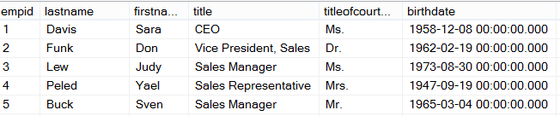
Ad Hoc Query
Stored Procedure
First Execution
or Recompile
Syntax
Parse
Execution Context
Resolve
(Binding)
Compile
Optimize
Execution Plan
Procedure Cache
Compile
Compile
Run Time
Execute
Execute
Execute
Execute
SQL
SQL
Sets
Sets
Notes:
This post will describe how a SQL Server will PROCESS a query. The first time through running an Ad Hoc query or Stored Procedure, SQL Server will go through each of the following steps.
The first step is to Parse the statement into keywords, expressions, and operators. This is where the syntax of your query statement is checked for accuracy. Both the first and second steps are where you will find syntax errors. In most cases, these errors are caused by misspellings or putting commas in the wrong place.
The second step is to Resolve object names (Tables, Views, Columns, etc.) to see if they exist. This step also resolves aliases of columns and tables, as well as, resolves data types and performs implicit data type conversions. As a side note, if you read other blog posts, this step is technically called the Binding phase. I personally call this step the Resolving phase to help spell the word PROCESS as a memorization tool and also to fit the steps on a single slide during presentations.
The third step is to Optimize the query. This is where the query optimizer will find different ways of locating data from your tables based on available indexes and/or statistics. Once it figures a good enough plan to retrieve your result set using the least amount of resources, it will create an Execution Plan. Errors would only occur during this stage if there is a lack of hardware resources. Most compile errors happen at the next step.
The fourth step is to Compile the Execution Plan and store it in the Procedure Cache for future use.
Finally, the Execution Plan is passed to the Storage Engine to Execute the query and hopefully return the desired SQL Sets. This is where Run-Time errors will occur that need to be managed by using Exception Handling. (SQL Sets are normally called recordsets or rowsets, but I’m making a blog post on the PROCESS of queries not the PBOCERS of queries).
Additional submissions of the query from a Stored Procedure, will check the Procedure Cache for existing or similar Execution Plans that could be re-used for the query. If this is the case, the existing Execution Plan will be used to retrieve the SQL Sets using the Execution Context of the Stored Procedure.
It is possible for an Ad Hoc query to also re-use an existing plan from the procedure cache if the only thing that has changed in the query is the parameter value. Example: If a query had been written WHERE ProductID = 732 and was re-written WHERE ProductID = 738 the execution plan could be re-used, but if anything else changed, even by adding a space, the optimizer would compile a new execution plan.
One final thing. You will notice that you can have both an Estimated Execution Plan and an Actual Execution Plan. The difference is the first will show you what the plan would look like before the plan is compiled and the second will additionally add the values of actually running the plan that was placed in the procedure cache and executed.

Slide 6
What does the binding step resolve?
Resolve aliases of columns and tables
Data types and if implicit data type conversions are needed.
Object names (Tables, Views, Columns, etc.) to see if they exist.
User permissions are checked.
Does a cached plan exist?
Notes:
This post will describe how a SQL Server will PROCESS a query. The first time through running an Ad Hoc query or Stored Procedure, SQL Server will go through each of the following steps.
The first step is to Parse the statement into keywords, expressions, and operators. This is where the syntax of your query statement is checked for accuracy. Both the first and second steps are where you will find syntax errors. In most cases, these errors are caused by misspellings or putting commas in the wrong place.
The second step is to Resolve object names (Tables, Views, Columns, etc.) to see if they exist. This step also resolves aliases of columns and tables, as well as, resolves data types and performs implicit data type conversions. This is also where user permissions are checked and if any cached plans exist. As a side note, if you read other blog posts, this step is technically called the Binding phase. I personally call this step the Resolving phase to help spell the word PROCESS as a memorization tool and also to fit the steps on a single slide during presentations.
The third step is to Optimize the query. This is where the query optimizer will find different ways of locating data from your tables based on available indexes and/or statistics. Once it figures a good enough plan to retrieve your result set using the least amount of resources, it will create an Execution Plan. Errors would only occur during this stage if there is a lack of hardware resources. Most compile errors happen at the next step.
The fourth step is to Compile the Execution Plan and store it in the Procedure Cache for future use.
Finally, the Execution Plan is passed to the Storage Engine to Execute the query and hopefully return the desired SQL Sets. This is where Run-Time errors will occur that need to be managed by using Exception Handling. (SQL Sets are normally called recordsets or rowsets, but I’m making a blog post on the PROCESS of queries not the PBOCERS of queries).
Additional submissions of the query from a Stored Procedure, will check the Procedure Cache for existing or similar Execution Plans that could be re-used for the query. If this is the case, the existing Execution Plan will be used to retrieve the SQL Sets using the Execution Context of the Stored Procedure.
It is possible for an Ad Hoc query to also re-use an existing plan from the procedure cache if the only thing that has changed in the query is the parameter value. Example: If a query had been written WHERE ProductID = 732 and was re-written WHERE ProductID = 738 the execution plan could be re-used, but if anything else changed, even by adding a space, the optimizer would compile a new execution plan.
One final thing. You will notice that you can have both an Estimated Execution Plan and an Actual Execution Plan. The difference is the first will show you what the plan would look like before the plan is compiled and the second will additionally add the values of actually running the plan that was placed in the procedure cache and executed.

Slide 7


Yes
Trivial Plan?
Query Plan Created
Phase 2
Compare Plans and Full Optimization
No
Phase 1b
Quick Parallel Plans
Query Optimizer Phases
Yes
No
Simplification and Statistics
Yes
No
Cost < 1.0
or
MAXDOP = 1
Cost > Cost Threshold for Parallelism
Yes
Simple Query Tables <= 3
Cost < 0.2
Phase 0 Transactional Processing
No
Phase 1a
Quick Serial Plans
Notes:
The SQL Server Query Optimizer uses cost-based optimization to create an execution plan with the least cost, but that also consumes the least amount of resources. The Query Optimizer will not evaluate all possible combinations of plans but will create a “Good Enough” plan based on available information such as statistics and the data distribution.
Trivial Plan Optimization: The Query Optimizer goes through several phases in the process of query optimization. First it must determine if the query has a trivial plan. Specially, a query that has only one plan to consider, such as, a SELECT statement where all the columns can be found in a single table or index. If a trivial plan is found, this saves the query optimizer from having to evaluate multiple plans, which reduces the workload of the optimizer. If a trivial plan is discovered then the optimization ends, and the query plan is created.
Non-Trivial Plan Optimization: When a trivial plan is unable to be generated, the query optimizer performs a simplification process to try to discover if unnecessary joins can be removed, operations can be rearranged, or commutative properties folded (Instead of 5 + 6, use 11 as a value). Additionally, before moving on to the next step, statistics, data distribution, and index metadata are added to the query tree.
Cost-based optimization: Now the query optimizer will evaluate the query across three search phases to quickly identify the plan with the least cost.
Phase 0 – Transactional Processing Phase: When online transaction processing (OTLP) queries are evaluated and there are three tables or less, the optimizer evaluates a limited number of join operators (merge, hash match, or loop) for potential plan candidates. If the estimated cost is less than 0.2 then the optimization ends, and the query plan is created.
Phase 1a – Quick Serial Plan Optimization: Additional join orders and transformation rules are evaluated to create a cost-effective serial plan. If the plan cost is less than 1.0 then the optimization ends, and the query plan is created.
Phase 1b – Quick Parallel Plan Optimization: At this point, if the cost of the plan is greater than 1.0, MAXDOP is set to a value greater than 1, and the plan cost is greater than the Cost Threshold for Parallelism; then the query optimizer repeats Phase 1 until it finds the most efficient parallel plan.
Phase 2 – Compare Plans and Full Plan Optimization: At this point the serial plan that had a cost greater than 1.0 but less than the Cost Threshold for Parallelism is compared with the most efficient parallel plan. The optimizer will then take the cheaper of the two plans and consider if there are any additional ways of optimizing the ·execution plan. At this point, the optimization ends, and the query plan is created.

Slide 8
Query Simplification phases
Constant Folding: Expressions with constant values are reduced
Quantity = 2 + 3 becomes Quantity = 5
10 < 20 becomes True
Contradiction Detection: Removes criteria that doesn’t match table constraints
Constraint: Age > 18
Contradiction: WHERE Age < 18
Domain Simplification: Reduces complex ranges to simple ranges
Complex range: ID > 10 and ID < 20 or ID > 30 and < 50
Simplified range: ID > 10 and < 50
Join Simplification: Removes redundant joins that are not necessary
Predicate Pushdown: Perform calculations only on rows returned
Notes:
The SQL Server Query Optimizer uses cost-based optimization to create an execution plan with the least cost, but that also consumes the least amount of resources. The Query Optimizer will not evaluate all possible combinations of plans but will create a “Good Enough” plan based on available information such as statistics and the data distribution.
Trivial Plan Optimization: The Query Optimizer goes through several phases in the process of query optimization. First it must determine if the query has a trivial plan. Specially, a query that has only one plan to consider, such as, a SELECT statement where all the columns can be found in a single table or index. If a trivial plan is found, this saves the query optimizer from having to evaluate multiple plans, which reduces the workload of the optimizer. If a trivial plan is discovered then the optimization ends, and the query plan is created.
Non-Trivial Plan Optimization: When a trivial plan is unable to be generated, the query optimizer performs a simplification process to try to discover if unnecessary joins can be removed, operations can be rearranged, or commutative properties folded (Instead of 5 + 6, use 11 as a value). Additionally, before moving on to the next step, statistics, data distribution, and index metadata are added to the query tree.
Cost-based optimization: Now the query optimizer will evaluate the query across three search phases to quickly identify the plan with the least cost.
Phase 0 – Transactional Processing Phase: When online transaction processing (OTLP) queries are evaluated and there are three tables or less, the optimizer evaluates a limited number of join operators (merge, hash match, or loop) for potential plan candidates. If the estimated cost is less than 0.2 then the optimization ends, and the query plan is created.
Phase 1a – Quick Serial Plan Optimization: Additional join orders and transformation rules are evaluated to create a cost-effective serial plan. If the plan cost is less than 1.0 then the optimization ends, and the query plan is created.
Phase 1b – Quick Parallel Plan Optimization: At this point, if the cost of the plan is greater than 1.0, MAXDOP is set to a value greater than 1, and the plan cost is greater than the Cost Threshold for Parallelism; then the query optimizer repeats Phase 1 until it finds the most efficient parallel plan.
Phase 2 – Compare Plans and Full Plan Optimization: At this point the serial plan that had a cost greater than 1.0 but less than the Cost Threshold for Parallelism is compared with the most efficient parallel plan. The optimizer will then take the cheaper of the two plans and consider if there are any additional ways of optimizing the ·execution plan. At this point, the optimization ends, and the query plan is created.

Slide 9
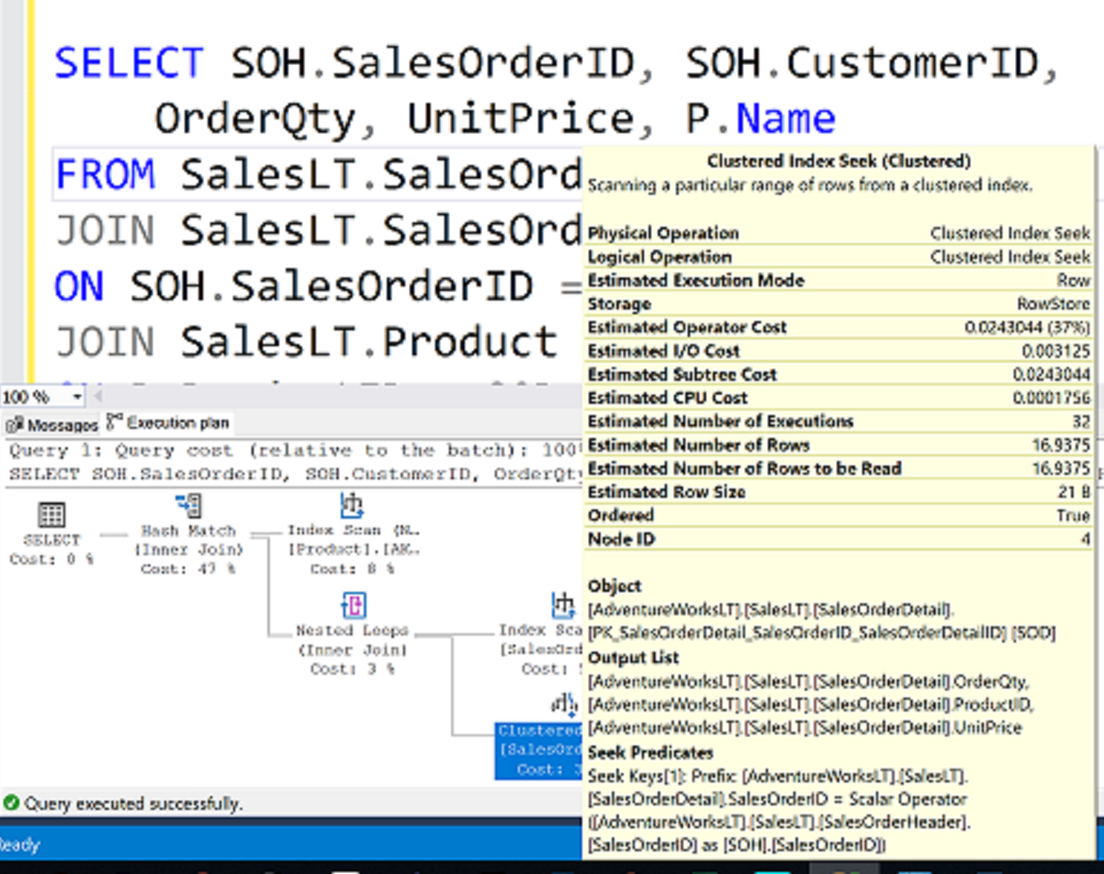
What is an Execution Plan?

Slide 10
How to see the query plan
Graphical execution plan
Estimated Execution Plan (Before Execution)
Live Query Statistics (During Execution)
Actual Execution Plan (After Execution)
The compiled plan.
The same as the compiled plan plus its execution context.
The same as the compiled plan plus its execution context.
This includes runtime information available after the execution completes, such as execution warnings, or in newer versions of the Database Engine, the elapsed and CPU time used during execution.
This includes runtime information during execution progress and is updated every second. Runtime information includes for example the actual number of rows flowing through the operators.
Enables rapid identification of potential bottlenecks.

Slide 11
SQL Server Execution Plan
Execution modes
Row mode execution
Batch mode execution
Efficient for Data Warehousing scenarios
Efficient for OLTP scenarios
Operators read all columns from qualifying rows based on predicate, and for each row it retrieves columns needed for the result set
Used to process multiple rows together
Closely integrated with, and optimized around the ColumnStore storage format
Operators read only the columns required for the result, from group of rows together.
Used with traditional tables, where data is stored in row-wise format.
Starting SQL Server 2019, Batch mode does not require a ColumnStore index as in the previous versions.
Notes:
Execution modes
The SQL Server Database Engine can process Transact-SQL statements using two distinct processing modes:
Row mode execution
Batch mode execution
Row mode execution
Row mode execution is a query processing method used with traditional RDMBS tables, where data is stored in row format. When a query is executed and accesses data in row store tables, the execution tree operators and child operators read each required row, across all the columns specified in the table schema. From each row that is read, SQL Server then retrieves the columns that are required for the result set, as referenced by a SELECT statement, JOIN predicate, or filter predicate.
Row mode execution is very efficient for OLTP scenarios, but can be less efficient when scanning large amounts of data, for example in Data Warehousing scenarios.
Batch mode execution
Batch mode execution is a query processing method used to process multiple rows together (hence the term batch). Each column within a batch is stored as a vector in a separate area of memory, so batch mode processing is vector-based. Batch mode processing also uses algorithms that are optimized for the multi-core CPUs and increased memory throughput that are found on modern hardware.
Batch mode execution is closely integrated with, and optimized around, the ColumnStore storage format. Batch mode processing operates on compressed data when possible and eliminates the exchange operator used by row mode execution. The result is better parallelism and faster performance.
When a query is executed in batch mode, and accesses data in ColumnStore indexes, the execution tree operators and child operators read multiple rows together in column segments. SQL Server reads only the columns required for the result, as referenced by a SELECT statement, JOIN predicate, or filter predicate. Batch mode execution is very efficient in Data Warehousing scenarios, where large amounts of data are read and aggregated.
For further information refer to:
https://docs.microsoft.com/en-us/sql/relational-databases/query-processing-architecture-guide

Slide 12
SQL Server Execution Plan
Main components
Compiled Plan (or Query Plan)
Compilation produces a query plan, which is a read-only data structure used by any number of users.
Execution Context
A data structure used to hold information specific to a query execution, such as parameter values.
Parameter A = ? Parameter B = ? User = ?
Parameter A = 12 Parameter B = ‘xy’ User = Jorge
Parameter A = 100 Parameter B = ‘ftr’ User = Nabil
Parameter A = 11 Parameter B = ‘sd’ User = Walter
Query Plan
Execution Context 1
Execution Context 2
Execution Context 3
Notes:
A query plan is the actual method that SQL Server uses to access data. While a Transact-SQL (T-SQL) statement indicates what the request is, the query plan indicates how to run the request.
Logical operators describe the relational algebraic operation used to process a statement. In other words, logical operators describe conceptually what operation needs to be performed.
Physical operators actually implement the operation defined by a logical operator using a concrete method or algorithm. For example, join is a logical operation, whereas nested loops join is a physical operator.
A Query Plan:
Is also known as an Execution Plan.
Is a re-entrant, read-only data structure used by any number of users.
Contains the data access strategy for the query.
Does not store any user context.
Is never stored more than twice in memory. There is one copy for all serial executions and possibly one copy for all parallel executions. The parallel copy covers all parallel executions, regardless of their degree of parallelism.
An Execution Context is derived from a query plan. Execution contexts:
Hold the values needed for a specific execution of a query plan.
Are cached and reused.
Are created for each user concurrently executing a batch and will hold data (such as parameter values) specific to their execution.
Are not re-entrant. At any point of time, an execution context can be executing only one batch submitted by a session, and while the execution is happening, the context is not given to any other session or user.

Slide 13
SQL Server Execution Plan Caching
Overview
Part of the memory pool used to store execution plans – also known as plan cache.
The plan cache has two stores for all compiled plans:
The Object Plans cache store (OBJCP)
used for plans related to persisted objects (stored procedures, functions, and triggers).
The SQL Plans cache store (SQLCP)
used for plans related to autoparameterized, dynamic, or prepared queries.
Notes:
For further information refer to:
https://docs.microsoft.com/en-us/sql/relational-databases/query-processing-architecture-guide

Slide 14
SQL Server compilation and execution
Concepts
Compilation
Process of creating a good enough query execution plan, as quickly as possible for a query batch.
Refer to both the compilation of non-DML constructs in SQL statements (control flow, DDL, etc.) and the process of Query Optimization.
Query Execution
Process of executing the plan that is created during query compilation and optimization.
Notes:
For further information refer to:
https://docs.microsoft.com/en-us/sql/relational-databases/query-processing-architecture-guide

Slide 15
SQL Server Execution Plan Recompilations
Overview
Most recompilations are required either for statement correctness or to obtain potentially faster query execution plan.
The engine detects changes that invalidate execution plan(s) and marks those as not valid. New plan must be recompiled for the next query execution.
Starting with SQL Server 2005, whenever a statement within a batch causes recompilation, only the statement inside the batch that triggers recompilation is recompiled.
Notes:
For further information refer to
https://docs.microsoft.com/en-us/sql/relational-databases/query-processing-architecture-guide
Plan Caching and Recompilation in SQL Server 2012 - https://docs.microsoft.com/en-us/previous-versions/sql/sql-server-2012/dn148262(v=msdn.10)

Slide 16
SQL Server Execution Plan Recompilations
Recompilation reasons
Table / Index Changes
Changes made to objects referenced by the query (ALTER TABLE and ALTER VIEW).
Changing or dropping any indexes used by the execution plan.
Stored Procedures
Changes made to a single procedure, which would drop all plans for that procedure from the cache (ALTER PROCEDURE).
Explicit call to sp_recompile.
Executing a stored procedure using the WITH RECOMPILE option.
Data Volume
Updates on statistics used by the execution plan
For tables with triggers, if the number of rows in the inserted or deleted tables grows significantly.
Other
Large numbers of changes to keys (generated by statements from other users that modify a table referenced by the query).
Temporary table changes

Slide 17

Questions?

Slide 18
Lesson 2: SQL Server Query Plan Analysis

Slide 19
Objectives
After completing this learning, you will be able to:
Read execution plans.
Understand logical and physical join operators.
Describe data access.

Slide 20
How to see the query plan
Graphical execution plan
Estimated Execution Plan (Before Execution)
Live Query Statistics (During Execution)
Actual Execution Plan (After Execution)
The compiled plan.
The same as the compiled plan plus its execution context.
The same as the compiled plan plus its execution context.
This includes runtime information available after the execution completes, such as execution warnings, or in newer versions of the Database Engine, the elapsed and CPU time used during execution.
This includes runtime information during execution progress and is updated every second. Runtime information includes for example the actual number of rows flowing through the operators.
Enables rapid identification of potential bottlenecks.

Slide 21
Contents of an Execution Plan
Methods used to extract data from each table.
How data is joined
Use of temporary worktables and sorts
Estimated rowcount, iterations, and costs from each operator
Actual rowcount and iterations
Sequence in which the source tables are accessed.

Slide 22
How to see the query plan
Text and XML
 | Command | Execute query? | Include estimated row counts & stats (Estimated Query Plan) | Include actual row counts & stats (Actual Query Plan)
Text Plan | SET SHOWPLAN_TEXT ON | No | No | No
 | SET SHOWPLAN_ALL ON | No | Yes | No
 | SET STATISTICS PROFILE ON | Yes | Yes | Yes
XML Plan | SET SHOWPLAN_XML ON | No | Yes | No
 | SET STATISTICS PROFILE XML | Yes | Yes | Yes

Slide 23
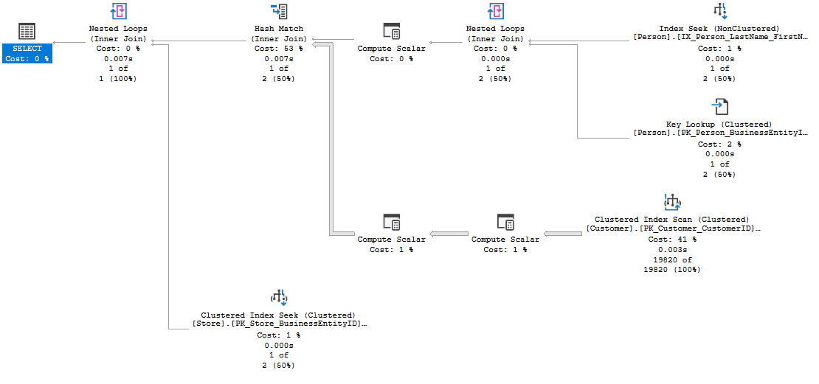

SSMS Graphical Plan
Execution Flow
5
3
1
3
Outer
Table
2
Inner table
4
6
Notes:
The basic guidelines for analyzing a query plan are:
Flow of data is read from right to left.
The width of the arrows gives an indication of the number of rows in each dataset, such as the one coming from the Customer table CL IX scan. This can often be a clue to high resource usage.
For joins:
The outer table appears on top.
Resultsets are created from each join pair, which is then passed to the next join.
Two crucial facts affect join performance:
The order in which more than two tables are joined.
The selection of outer/inner table.
Joins producing smaller result sets are performed first.
Local predicates are applied before the join.
Joins that reduce the number of rows are performed first.
Aggregation may be performed before the join.
This is all dependent on the accuracy of the statistics the Microsoft SQL Server Query processor has at compilation time.
Example Query:
SELECT p.Title + ' ' + p.FirstName + ' ' + p.LastName AS FullName, c.AccountNumber, s.Name
FROM Person.Person AS p
INNER JOIN Sales.Customer AS c ON c.PersonID = p.BusinessEntityID
INNER JOIN Sales.Store AS s ON s.BusinessEntityID = c.StoreID
WHERE p.LastName = 'Koski’
Resultset 1 and 2 are joined using a nested loops join, creating resultset 3.
Resultsets 3 and 4 are joined using a hash match join, creating resultset 5.
Resultsets 5 and 6 are joined using a nested loops join, creating a resultset for the Select clause.

Slide 24
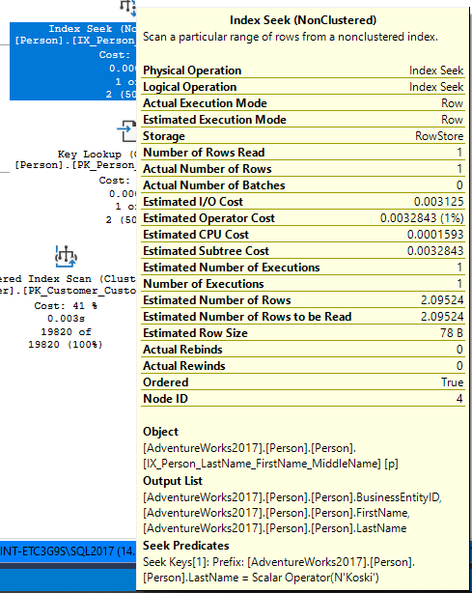
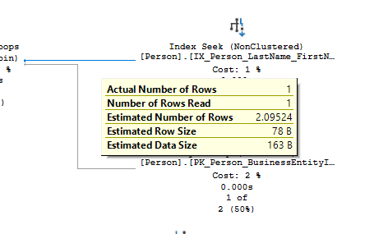
SSMS Graphical Plan
Data flow between the operators and statistical data of each operator
Statistical data for the operator
Data flow statistics
Notes:
Arrows represent the data flow between the iterators.
ToolTips provide detailed help, including a description of statistical data on each iterator; this includes estimates of the number of rows generated by each operator (that is, the cardinality estimates), the average row size, and the cost of the operator.

Slide 25
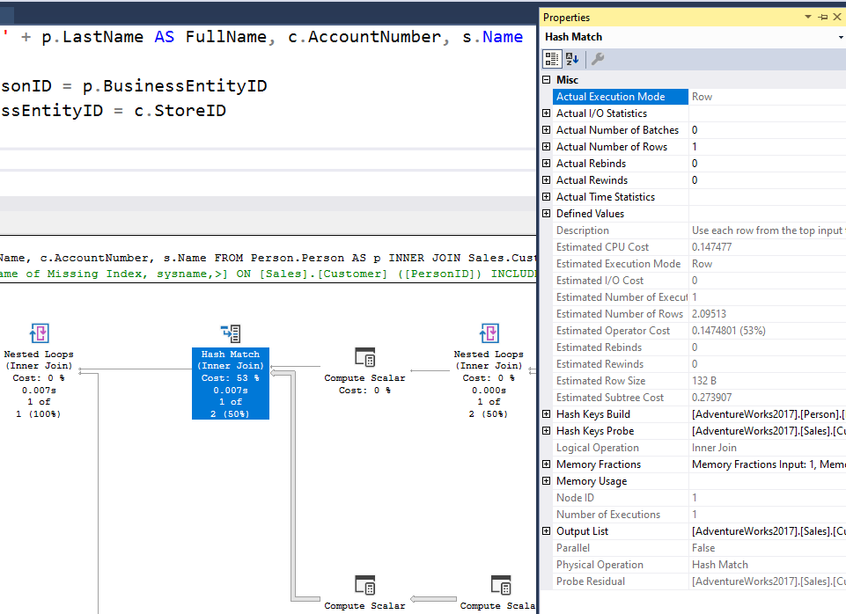
SSMS Graphical Plan
Properties sheet
Management Studio Properties sheet includes even more detailed information about each operator and about the overall query plan.
Use the most recent version of Management Studio as every new version display more detailed information about the Query Plan when examining the plan in graphical mode.
Notes:
The Management Studio Properties sheet includes even more detailed information about each operator and about the overall query plan.

Slide 26
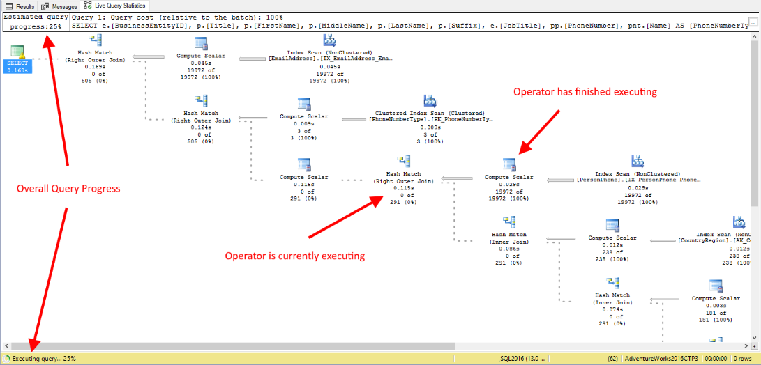
SSMS Graphical Plan
Live Query Statistics
View CPU/memory usage, execution time, and query progress
Allows drill down to live operator-level statistics, such as:
Number of generated rows
Elapsed time
Operator progress
Live warnings
This feature is primarily intended for troubleshooting purposes.
Using this feature can moderately slow the overall query performance.
Notes:
SQL Server Management Studio provides the ability to view the live execution plan of an active query. This live query plan provides real-time insights into the query execution process as the controls flow from one query plan operator to another. The live query plan displays the overall query progress and operator-level run-time execution statistics such as the number of rows produced, elapsed time, operator progress, and so on. Because this data is available in real time without needing to wait for the query to complete, these execution statistics are extremely useful for debugging query performance issues.
This feature is available beginning with SQL Server 2016 (13.x) Management Studio, however it can work with SQL Server 2014 (12.x).
Internally, live query statistics leverages the sys.dm_exec_query_profiles DMV.
To view live query statistics for one query, on the tools menu click the Include Live Query Statistics icon. The live execution plan can also be accessed from the Activity Monitor.
For further information refer to:
https://docs.microsoft.com/en-us/sql/relational-databases/performance/live-query-statistics

Slide 27












Execution Plan
Notable operators
Operators describe how SQL Server executes a query. The query optimizer uses operators to build a query plan to create the result specified in the query.
Table scan
Nonclustered index scan
Clustered index scan
Nonclustered index seek
Clustered index seek
Sort
RID lookup
Table spool
Key lookup
Index spool
ColumnStore Index Scan
Stream Aggregation
Notes:
For further information refer to:
https://docs.microsoft.com/en-us/sql/relational-databases/showplan-logical-and-physical-operators-reference

Slide 28
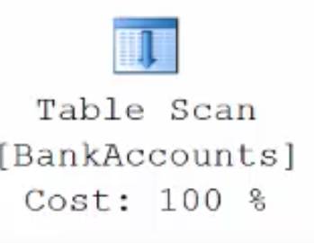
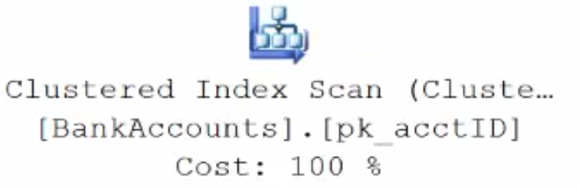
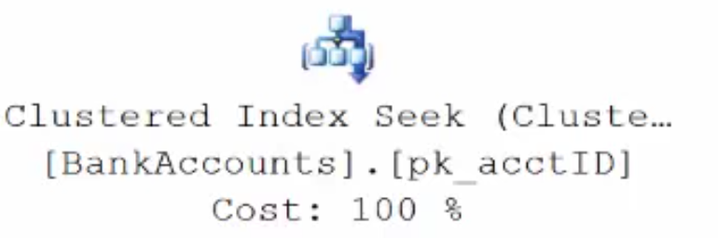
Execution Plan Table Operators
Data stored in a Heap is not stored in any order and normally does not have a Primary Key.
Clustered Index data is stored in sorted order by the Clustering key. In many cases, this is the same value as the Primary Key.
Using a WHERE statement on an Index could possibly have the Execution Plan seek the Index instead of scan.

Slide 29
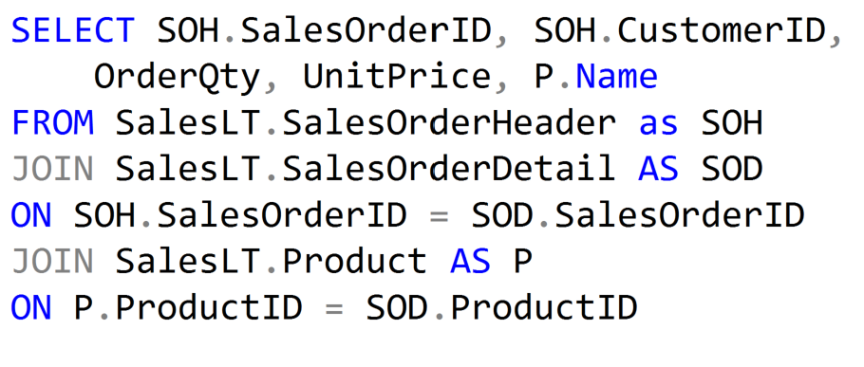
Execution Plan Join Operators (Code)

Slide 30
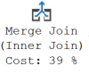
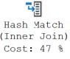
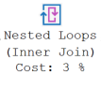
Execution Plan Join Operators
A Merge Join is useful if both table inputs are in the same sorted order on the same value.
A Hash Match is used when the tables being joined are not in the same sorted order.
A Nested Loop is use when a small (outer) table is used to lookup a value in a larger (inner) table.

Slide 31
What to look for in the query plan
Top Left Operator
Expensive Operators
Nested Loop Operator
Scans vs Seeks
Skewed Estimates
Warnings
Data Flow Statistics
Information about possible issues with the plan
Overall properties of the plan
Look from most expensive to least expensive
Thicker arrows mean more data is being passed
Possible to create index that covers query
Not necessarily bad, but could indicate I/O issues
Statistics could be stale or invalid

Slide 32

Demonstration
Query Plan Analysis
Use the graphical execution plan and IO statistics to tune a query.
Explore Live Query Statistics.
Notes:
M07L03Demo01
Go to the Lab VM
Go through e:\Demos\M07L03Demo01\AnalyzingPlanOperators.sql
Go through e:\Demos\M07L03Demo01\LiveQueryStatistics.sql

Slide 33
Questions?

Slide 34
Lesson 3: SQL Server Plan Cache Internals

Slide 35
Objectives
After completing this learning, you will be able to:
Describe the purpose and contents of the plan cache.
Query the plan cache using Dynamic Management Objects.
Discuss the pros and cons of plan reuse.
Explain why ad hoc SQL statements can be especially problematic.
Notes:
Block of SQL Server’s working set memory dynamically shared with the buffer pool.
Contains compiled and optimized query plans for reuse.
This is generally beneficial as creating query plans is costly both in time and CPU.
But, plan reuse isn’t always appropriate as when differing parameters yield results sets of widely varying sizes. Like, Nested Loop Joins are a cost-effective way to join smaller result sets, but are prohibitively expensive for very large result sets.
Ad hoc SQL statements are less likely to be reused as the text of subsequent SQL statements much match exactly to achieve reuse. This can bloat the plan cache with single-use plans. Address this by enabling the Optimize for ad hoc workloads server configuration option. Also use parameterized SQL and stored procedures in preference to ad hoc SQL.

Slide 36
The Plan Cache
A pool of memory used to store query execution plans
All databases in a SQL Server instance
Avoid repeated optimization and compilation
Vary over time
Can grow (within limits) to hold more and/or larger plans
Can shrink under memory pressure, by evicting plans
Is
Is used by
Exists to
Size and contents
Reuse of plans offers performance benefits, as Optimization and compilation costs time and CPU
With a fixed amount of memory, when the plan cache grows the buffer pool shrinks and vice-versa
SQL Server’s Memory
Plan
Cache
Buffer Pool
Other
Notes:
Maximum number of entries the plan cache can hold:
160,036 total entries
40,009 entries each for SQL Plans, Object Plans, Bound Trees, Extended SPs
Heavy ad hoc workloads may fill up the SQL Plans bucket and result in SOS_CACHESTORE spinlock contention.
This can be addressed with -T174 which increases the bucket count by 4X.
Maximum size the plan cache can reach:
75% of visible target memory from 0 to 4GB
+ 10% of visible target memory from 4GB to 64GB
+ 25% of visible target memory > 64GB
The “Optimize for ad hoc workload” server configuration option helps control the cache size.
When object plans are cached their compilation cost is noted. Under memory pressure that value is decremented. On plan reuse it is reset.
Ad hoc plans are cached with a cost of 0. This value is incremented on plan reuse.
Plans that have a cost of 0 may be evicted from the cache.

Slide 37
Dynamic Management Views and Functions
Category | Description
sys.dm_exec_% | Execution and connection information
sys.dm_os_% | Operating system related information
sys.dm_tran_% | Transaction management information
sys.dm_io_% | I/O related information
sys.dm_db_% | Database information
Notes:
While all this has been running, several other parts of SQLOS have been active:
Monitoring: DMVs, Extended Events (xEvents), and so on.
Deadlock Monitor thread: Monitors for and deals with deadlocks.
Lazy Writer threads: Clock sweeping the buffer pool to maintain the free lists and responsible for writing dirty pages to disk between checkpoints.
Scheduler Monitor thread: Monitors scheduler health and detects issues such as non-yielding scenarios.
Resource Monitor thread: Monitors available memory from operating system and internal to SQL Server and notifies the Clerks.
The Hosting APIs for external components interface with Microsoft Data Access Components (MDAC) and common language runtime (CLR).

Slide 38
Dynamic Management Objects
sys.dm_exec_cached_plans
Plan type, size and handle
sys.dm_exec_query_stats
Execution metrics for individual statements
sys.dm_exec_query_plan()
Takes a plan_handle and returns the associated XML plan
sys.dm_exec_sql_text()
Takes a plan_handle or sql_handle and returns the associated SQL batch
Notes:
sys.dm_exec_cached_plans
https://docs.microsoft.com/en-us/sql/relational-databases/system-dynamic-management-views/sys-dm-exec-cached-plans-transact-sql?view=sql-server-ver15
sys.dm_exec_query_stats
https://docs.microsoft.com/en-us/sql/relational-databases/system-dynamic-management-views/sys-dm-exec-query-stats-transact-sql?view=sql-server-ver15
In addition to query-stats, consider the following stats:
sys.dm_exec_procedure_stats
https://docs.microsoft.com/en-us/sql/relational-databases/system-dynamic-management-views/sys-dm-exec-procedure-stats-transact-sql?view=sql-server-ver15
sys.dm_exec_trigger_stats
https://docs.microsoft.com/en-us/sql/relational-databases/system-dynamic-management-views/sys-dm-exec-trigger-stats-transact-sql?view=sql-server-ver15
sys.dm_exec_function_stats
https://docs.microsoft.com/en-us/sql/relational-databases/system-dynamic-management-views/sys-dm-exec-function-stats-transact-sql?view=sql-server-ver15
sys.dm_exec_query_plan()
https://docs.microsoft.com/en-us/sql/relational-databases/system-dynamic-management-views/sys-dm-exec-query-plan-transact-sql?view=sql-server-ver15
sys.dm_exec_sql_text()
https://docs.microsoft.com/en-us/sql/relational-databases/system-dynamic-management-views/sys-dm-exec-sql-text-transact-sql?view=sql-server-ver15

Slide 39
Relationships between DMOs
sys.dm_exec_cached_plans
plan_handle
sys.dm_exec_query_stats
plan_handle
plan_handle
or sql_handle
sys.dm_exec_query_plan()
sys.dm_exec_sql_text()

Slide 40
Captured Metrics (sys.dm_exec_query_stats )
Partial listing
Execution count
Worker time
Physical read
Logical reads
Memory consumption
Elapsed time
Row count
Spills
…
Aggregate statistics
Total
Last
Max
Min
Compute Average: Avg = Total / Execution count
Notes:
For the complete list see the sys.dm_exec_query_stats documentation:
https://docs.microsoft.com/en-us/sql/relational-databases/system-dynamic-management-views/sys-dm-exec-query-stats-transact-sql?view=sql-server-ver15

Slide 41
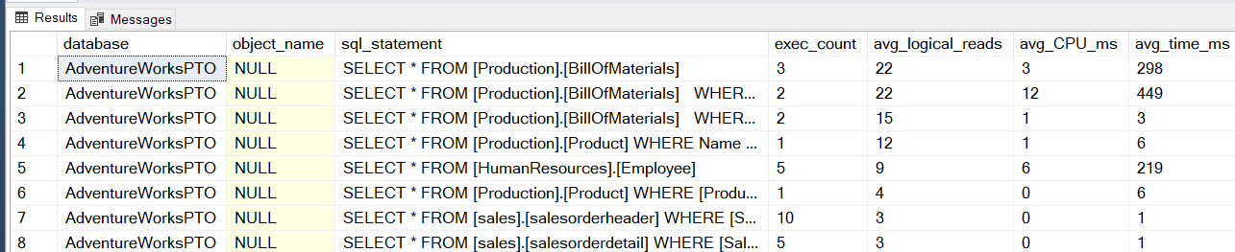
Mining the Plan Cache with T-SQL
Top 10 plans by logical reads
SELECT CASE st.dbid WHEN 32767 THEN 'resourcedb'
WHEN NULL THEN 'NA' ELSE DB_NAME(st.dbid)END AS [database], OBJECT_NAME(st.objectid) AS object_name,
SUBSTRING( st.text, ( qs.statement_start_offset / 2 ) + 1,
(( CASE qs.statement_end_offset WHEN -1 THEN DATALENGTH(st.text)
ELSE qs.statement_end_offset END - qs.statement_start_offset ) / 2 ) + 1) AS sql_statement,
qs.exec_count, qs.avg_logical_reads, qs.avg_CPU_ms, qs.avg_time_ms, qs.avg_logical_writes, qp.query_plan
FROM ( SELECT TOP ( 10 ) plan_handle, statement_start_offset, statement_end_offset,
execution_count AS exec_count,
total_worker_time / ( execution_count * 1000 ) AS avg_CPU_ms,
( total_elapsed_time / ( execution_count * 1000 )) AS avg_time_ms,
CASE WHEN total_logical_reads > 0 THEN ( total_logical_reads / execution_count )
ELSE 0 END AS avg_logical_reads,
CASE WHEN total_logical_writes > 0 THEN ( total_logical_writes / execution_count )
ELSE 0 END AS avg_logical_writes
FROM sys.dm_exec_query_stats
ORDER BY ( total_logical_reads / execution_count ) DESC ) AS qs
CROSS APPLY sys.dm_exec_sql_text(qs.plan_handle) st
CROSS APPLY sys.dm_exec_query_plan(qs.plan_handle) qp
ORDER BY qs.avg_logical_reads DESC
OPTION ( RECOMPILE );
Vary the subquery ORDER BY metrics to identify top queries by other measures:
total_worker_time/execution_count
total_elapsed_time/execution_count
execution_count
etc.
…
Notes:
sys.dm_exec_sql_text() returns all the SQL statements in a batch.
The offset values from sys.dm_exec_query_stats are used to pick out the specific statement to which the plan and query stats apply.
Vary the ORDER BY statement in the displayed query to identify the TOP 10 queries by other measures:
ORDER BY execution_count DESC ) AS qs
ORDER BY ( total_logical_reads / execution_count ) DESC ) AS qs
ORDER BY (total_worker_time / execution_count ) DESC ) AS qs
ORDER BY ( total_elapsed_time / execution_count ) DESC ) AS qs
Etc.

Slide 42
Mining the Plan Cache using XQuery
Plans with implicit conversions
WITH XMLNAMESPACES (DEFAULT 'http://schemas.microsoft.com/sqlserver/2004/07/showplan'), Convertsearch AS (
SELECT qp.query_plan, cp.usecounts, cp.objtype, cp.plan_handle, cs.query('.') AS StmtSimple
FROM sys.dm_exec_cached_plans cp (NOLOCK)
CROSS APPLY sys.dm_exec_query_plan(cp.plan_handle) qp
CROSS APPLY qp.query_plan.nodes('//StmtSimple') AS p(cs)
WHERE
cp.cacheobjtype = 'Compiled Plan' AND cs.exist('@QueryHash') = 1
AND cs.exist('.//ScalarOperator[contains(@ScalarString, "CONVERT_IMPLICIT")]') = 1
AND cs.exist('.[contains(@StatementText, "Convertsearch")]') = 0
)
SELECT
c2.value('@StatementText', 'VARCHAR(4000)') AS sql_text, c2.value('@StatementId', 'int') AS StatementId,
c3.value('@ScalarString[1]','VARCHAR(4000)') AS expression, ss.usecounts, ss.query_plan,
StmtSimple.value('StmtSimple[1]/@QueryHash', 'VARCHAR(100)') AS query_hash,
StmtSimple.value('StmtSimple[1]/@QueryPlanHash', 'VARCHAR(100)') AS query_plan_hash,
StmtSimple.value('StmtSimple[1]/@StatementSubTreeCost', 'sysname') AS StatementSubTreeCost,
c2.value('@EstimatedTotalSubtreeCost','sysname') AS EstimatedTotalSubtreeCost,
StmtSimple.value('StmtSimple[1]/@StatementOptmEarlyAbortReason', 'sysname') AS StatementOptmEarlyAbortReason,
StmtSimple.value('StmtSimple[1]/@StatementOptmLevel', 'sysname') AS StatementOptmLevel, ss.plan_handle
FROM
Convertsearch ss
CROSS APPLY query_plan.nodes('//StmtSimple') AS q2(c2)
CROSS APPLY c2.nodes('.//ScalarOperator[contains(@ScalarString, "CONVERT_IMPLICIT")]') AS q3(c3)
OPTION(RECOMPILE, MAXDOP 1);
SELECT * FROM Person.Address WHERE Addressid = 910
SELECT * FROM Person.Address WHERE Addressid = '910'
SELECT * FROM Person.Address WHERE Addressid = N'910'
Notes:
For additional examples see:
tigertoolbox/Mining-PlanCache
https://github.com/microsoft/tigertoolbox/tree/master/Mining-PlanCache

Slide 43
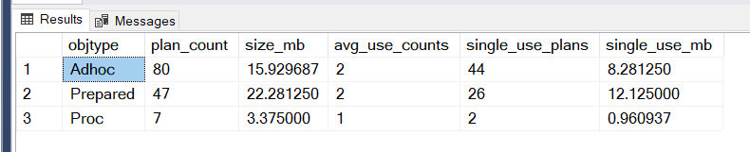
Cache Plan Bloat
Caused by ad hoc SQL
Heavy ad hoc workloads can bloat the plan cache
Enable “optimize for ad hoc workload” to keep single-use plans out of the cache
No benefit to caching single-use, ad hoc plans
-- Plan cache contents and memory use by object type
SELECT objtype, COUNT_BIG(*) AS plan_count, SUM(CAST(size_in_bytes AS DECIMAL(12, 2)))/(1024*1024) AS size_mb,
AVG(usecounts) AS avg_use_counts, SUM(CASE WHEN usecounts = 1 THEN 1 ELSE 0 END) AS single_use_plans,
SUM(CAST((CASE WHEN usecounts = 1 THEN size_in_bytes
ELSE 0 END) AS DECIMAL(12, 2)))/(1024*1024) AS single_use_mb
FROM sys.dm_exec_cached_plans
WHERE cacheobjtype = N'Compiled Plan'
GROUP BY objtype;
EXEC sp_configure 'optimize for ad hoc workload', 1;
GO
RECONFIGURE
GO
Notes:
optimize for ad hoc workloads Server Configuration Option
https://docs.microsoft.com/en-us/sql/database-engine/configure-windows/optimize-for-ad-hoc-workloads-server-configuration-option?view=sql-server-ver15
The optimize for ad hoc workloads option is used to improve the efficiency of the plan cache for workloads that contain many single use ad hoc batches. When this option is set to 1, the Database Engine stores a small compiled plan stub in the plan cache when a batch is compiled for the first time, instead of the full compiled plan. This helps to relieve memory pressure by not allowing the plan cache to become filled with compiled plans that are not reused.
The compiled plan stub allows the Database Engine to recognize that this ad hoc batch has been compiled before but has only stored a compiled plan stub, so when this batch is invoked (compiled or executed) again, the Database Engine compiles the batch, removes the compiled plan stub from the plan cache, and adds the full compiled plan to the plan cache.
Avoid having a large number of single-use plans in the plan cache. A common cause of this problem is when the data types of query parameters is not consistently defined. This particularly applies to the length of strings but can apply to any data type that has a maxlength, a precision, or a scale. For example, if a parameter named @Greeting is passed as an nvarchar(10) on one call and an nvarchar(20) on the next call, separate plans are created for each parameter size. If a query has several parameters and they are not consistently defined when called, a large number of query plans could exist for each query. Plans could exist for each combination of query parameter data types and lengths that have been used.

Slide 44
Clearing the Plan Cache
Not always the best option!
The entire plan cache – all databases
DBCC FREEPROCCACHE;
All plans of a specific type
DBCC FREESYSTEMCACHE ('SQL Plans');
All plans for a single database
ALTER DATABASE SCOPED CONFIGURATION CLEAR PROCEDURE_CACHE;
A specific plan
ALTER DATABASE SCOPED CONFIGURATION CLEAR PROCEDURE_CACHE(<plan_handle>);
Performance impact as new plans are compiled
Notes:
DBCC FREEPROCCACHE [ ( { plan_handle | sql_handle | pool_name } ) ] [ WITH NO_INFOMSGS ]
https://docs.microsoft.com/en-us/sql/t-sql/database-console-commands/dbcc-freeproccache-transact-sql?view=sql-server-ver15
Removes all elements from the plan cache, removes a specific plan from the plan cache by specifying a plan handle or SQL handle, or removes all cache entries associated with a specified resource pool.
DBCC FREESYSTEMCACHE ( 'ALL' [, pool_name ] ) [WITH { [ MARK_IN_USE_FOR_REMOVAL ] , [ NO_INFOMSGS ] } ]
https://docs.microsoft.com/en-us/sql/t-sql/database-console-commands/dbcc-freesystemcache-transact-sql?view=sql-server-ver15
Releases all unused cache entries from all caches – not just the plan cache. Using the ‘SQL Plans’ parameter will flush both ad hoc and prepared plans from the cache.

Slide 45
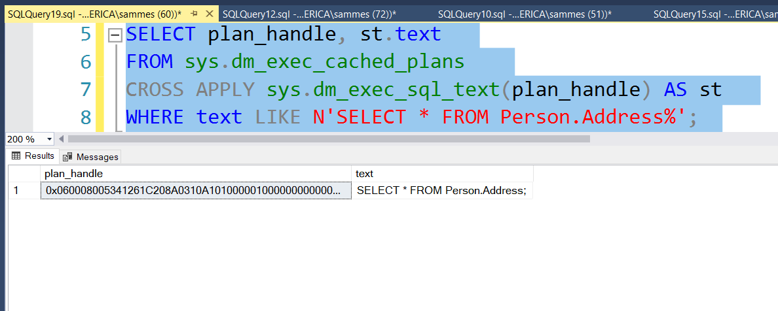
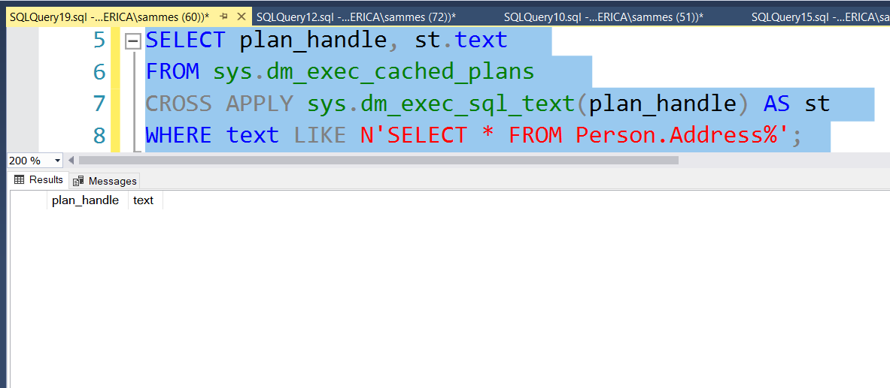
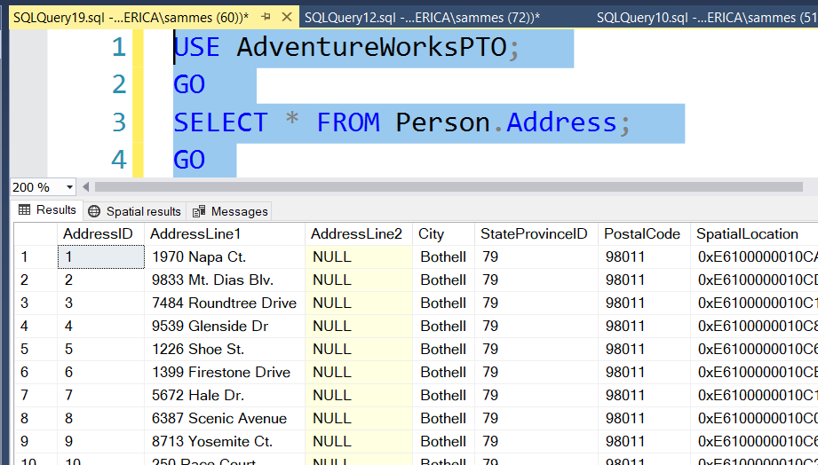
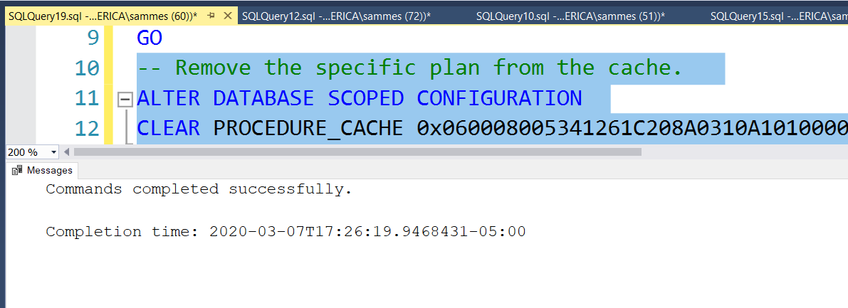
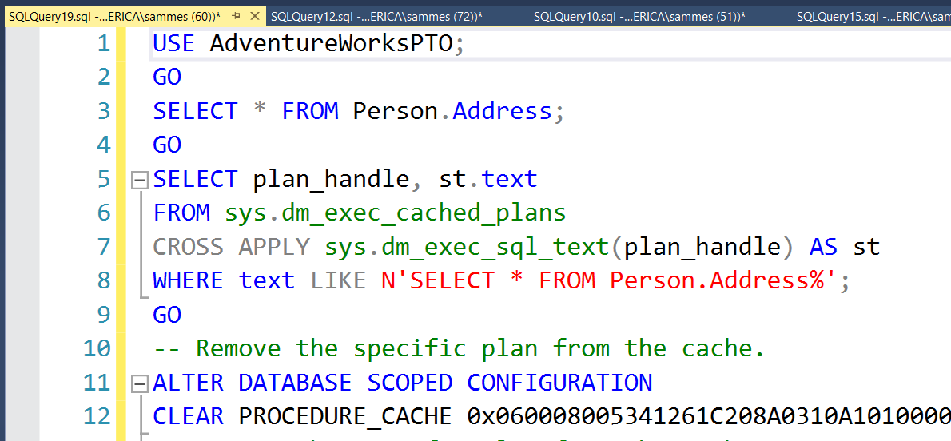
Clearing the Plan Cache
Not your first option!
The entire plan cache – all databases
ALTER DATABASE SCOPED CONFIGURATION CLEAR PROCEDURE_CACHE;
All plans of a specific type
DBCC FREESYSTEMCACHE ('SQL Plans’);
All plans for a single database
ALTER DATABASE SCOPED CONFIGURATION CLEAR PROCEDURE_CACHE;
A specific plan
ALTER DATABASE SCOPED CONFIGURATION CLEAR PROCEDURE_CACHE <plan_handle>;
Performance impact as new plans are compiled
Notes:
-- SAMPLE CODE:
-- for 1 QUERY USE AdventureWorksPTO;
GO
SELECT * FROM Person.Address;
GO
SELECT plan_handle, st.text
FROM sys.dm_exec_cached_plans
CROSS APPLY sys.dm_exec_sql_text(plan_handle) AS st
WHERE text LIKE N'SELECT * FROM Person.Address%';
GO
-- Remove the specific plan from the cache.
ALTER DATABASE SCOPED CONFIGURATION
CLEAR PROCEDURE_CACHE 0x060008005341261C208A0310A101000001000000000000000000000000000000000000000000000000000000;
-- Remove the specific plan from the cache.
DBCC FREEPROCCACHE (0x060008005341261C208A0310A101000001000000000000000000000000000000000000000000000000000000);
GO
-- for all queries for the database:
USE AdventureWorksPTO;
GO
SELECT * FROM Person.Address;
GO
SELECT * FROM Person.Address WHERE addressId = 2;
GO
SELECT * FROM Person.Address WHERE StateProvinceID=79;
GO
SELECT plan_handle, st.text
FROM sys.dm_exec_cached_plans
CROSS APPLY sys.dm_exec_sql_text(plan_handle) AS st
WHERE text LIKE N'SELECT * FROM Person.Address%';
GO
-- REMOVE all plans for database
ALTER DATABASE SCOPED CONFIGURATION CLEAR PROCEDURE_CACHE;
DBCC FREEPROCCACHE [ ( { plan_handle | sql_handle | pool_name } ) ] [ WITH NO_INFOMSGS ]
https://docs.microsoft.com/en-us/sql/t-sql/database-console-commands/dbcc-freeproccache-transact-sql?view=sql-server-ver15
Removes all elements from the plan cache, removes a specific plan from the plan cache by specifying a plan handle or SQL handle, or removes all cache entries associated with a specified resource pool.
DBCC FREESYSTEMCACHE ( 'ALL' [, pool_name ] ) [WITH { [ MARK_IN_USE_FOR_REMOVAL ] , [ NO_INFOMSGS ] } ]
https://docs.microsoft.com/en-us/sql/t-sql/database-console-commands/dbcc-freesystemcache-transact-sql?view=sql-server-ver15
Releases all unused cache entries from all caches – not just the plan cache. Using the ‘SQL Plans’ parameter will flush both ad hoc and prepared plans from the cache.

Slide 46
Plan Reuse
Requires that SQL statements match exactly
Any difference in casing, white space or literal values will affect a hashed value
Less likely for ad hoc SQL statements
Simple (on by default) or Forced Parameterization can improve reuse
Most easily achieved using:
Stored procedures, Functions, Triggers
Prepared statements and parameterized queries (sp_executesql)
-- Small changes in case or white space yield differing hashes
SELECT HASHBYTES('MD5','SELECT * FROM Person.Person') UNION ALL
SELECT HASHBYTES('MD5','SELECT * FROM person.Person') UNION ALL
SELECT HASHBYTES('MD5','SELECT * FROM Person.Person')
/*
0xF2D4F28DA93156A5BB487B019F1F0191
0x76F700BB3DC09FF482E1E4A77C7392E8
0xB1D875A858F4D410D9E866C40E523683
*/
Notes:
ALTER DATABASE SET PARAMETERIZATION { SIMPLE | FORCED };
https://docs.microsoft.com/en-us/sql/t-sql/statements/alter-database-transact-sql-set-options?view=sql-server-ver15
Simple Parameterization
https://docs.microsoft.com/en-us/sql/relational-databases/query-processing-architecture-guide?view=sql-server-ver15#SimpleParam
Forced Parameterization
https://docs.microsoft.com/en-us/sql/relational-databases/query-processing-architecture-guide?view=sql-server-ver15#ForcedParam
How Simple Parameterization works
https://docs.microsoft.com/en-us/archive/blogs/psssql/how-simple-parameterization-works
Simple parameterization is enabled by default. Check the StatementParameterizationType attribute value in an actual execution plan to see whether parameterization applied. The values are documented in sys.query_store_query:
0 = None
1 = User
2 = Simple
3 = Forced
Note the use (and value of) UNION ALL compared to UNION (which has an implicit DISTINCT)

Slide 47
Plan Reuse
Improved performance as reuse saves time and CPU
Degraded performance when reused plan is not optimal for all parameter values
Benefit
Drawback
Parameter Sniffing
Optimizer’s ability to see (sniff) parameter values at compile time and so create a cost-effective execution plan.
Recompile hints
Prevent caching of plans at the object or statement (preferred) level
sp_recompile <object_name> to manually force recompilation
Only problematic when compile parameters aren’t representative
This is generally beneficial.
Notes:
https://docs.microsoft.com/en-us/sql/t-sql/queries/hints-transact-sql-query?view=sql-server-ver15
OPTION(RECOMPILE) query hint Instructs the SQL Server Database Engine to generate a new, temporary plan for the query and immediately discard that plan after the query completes execution. The generated query plan doesn't replace a plan stored in cache when the same query runs without the RECOMPILE hint. Without specifying RECOMPILE, the Database Engine caches query plans and reuses them. When compiling query plans, the RECOMPILE query hint uses the current values of any local variables in the query. If the query is inside a stored procedure, the current values passed to any parameters.
https://docs.microsoft.com/en-us/sql/t-sql/statements/create-procedure-transact-sql?view=sql-server-ver15
CREATE PROC dbo.MyProc WITH RECOMPILE Indicates that the Database Engine does not cache a query plan for this procedure, forcing it to be compiled (all statements) each time it is executed.
Use of the statement-level OPTION (RECOMPILE) hint is preferred.
sp_recompile
https://docs.microsoft.com/en-us/sql/relational-databases/system-stored-procedures/sp-recompile-transact-sql?view=sql-server-ver15

Slide 48
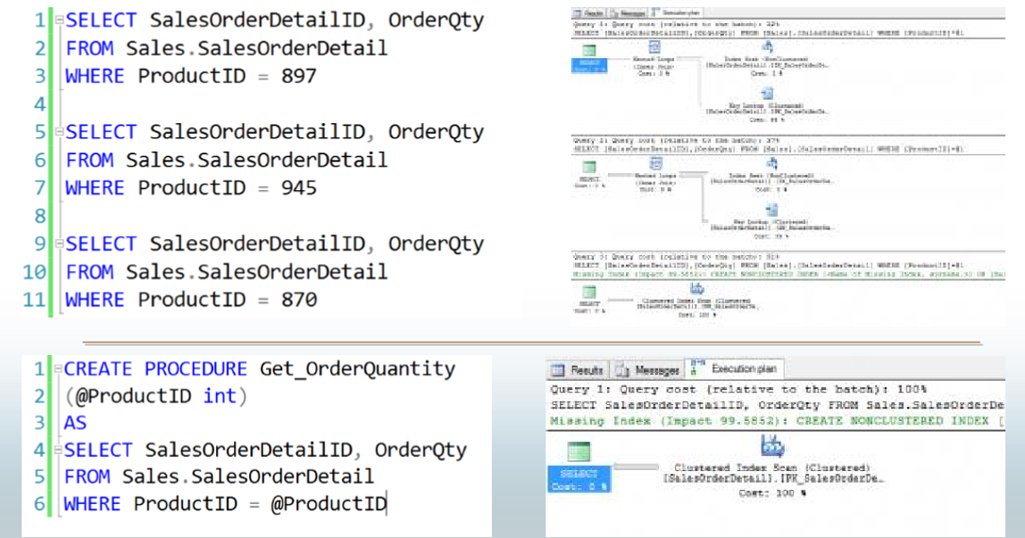
Parameter Sniffing
Notes:
When a parameterized batch or stored procedure is compiled for the first time, the values of the parameters supplied with the execution call are used to optimize the statements. This process is known as parameter sniffing. If these values are typical, then most calls to that stored procedure will benefit from an efficient query plan.
CREATE PROCEDURE testProc @p1 int = null
AS
BEGIN
If @p1 IS NULL
Begin
Select @p1 = 9999
End
SELECT *
FROM sales.target
WHERE amount = @p1
END
Issues generally arise in two scenarios:
The sniffed parameter value is not typical of the values that are actually used during a typical execution.
The parameter is changed within a stored procedure before it is used in a query-parameterized queries will behave in a similar manner to batches that have been explicitly parameterized. That is, if the first execution of a query uses an atypical value when it is compiled, similar queries that share the execution plan through simple or forced parameterization may have inaccurate cardinality estimates.
Repeat of previous page

Slide 49
Knowledge Check
Is the size of the plan cache fixed?
How long do query plans remain in the plan cache?
Why is plan caching helpful?
Why are ad hoc query plans sometimes problematic?
What can be done to address a parameter sniffing issue?
What can be done to lessen the impact of an ad hoc workload?
Notes:
Q1) Is the size of the plan cache fixed?
A1) No. It grows on demand, within limits, and can shrink when there’s memory pressure.
Q2) How long do query plans remain in the plan cache?
A2) Until memory pressure forces them out.
Q3) Why is plan caching helpful?
A3) Plan reuse saves time and CPU since a new plan needn’t be compiled every time a statement is executed.
Q4) Why are ad hoc query plans sometimes problematic?
A4) They are often single-use both because of their nature (users browsing data) and because small changes in SQL text impact the ability of the Optimizer to match current queries to cached plans. This can lead to filling up the plan cache with plans that will never be reused – a waste of space that may negatively impact the size of the buffer pool.
Q5) What can be done to lessen the impact of an ad hoc workload?
A5) Address this by enabling the “optimize for ad hoc workload” server configuration item. This prevents full caching of plans until they’ve been used a second time.
Q6) What can be done to address a parameter sniffing issue?
A6) You can use statement-level recompile hints to ensure you have cost-effective plans for all executions of a statement. Recompile hints simply prevent caching of the query plans for statements in their scope (object or statement).

Slide 50
Lesson 4: SQL Server Query Store

Slide 51
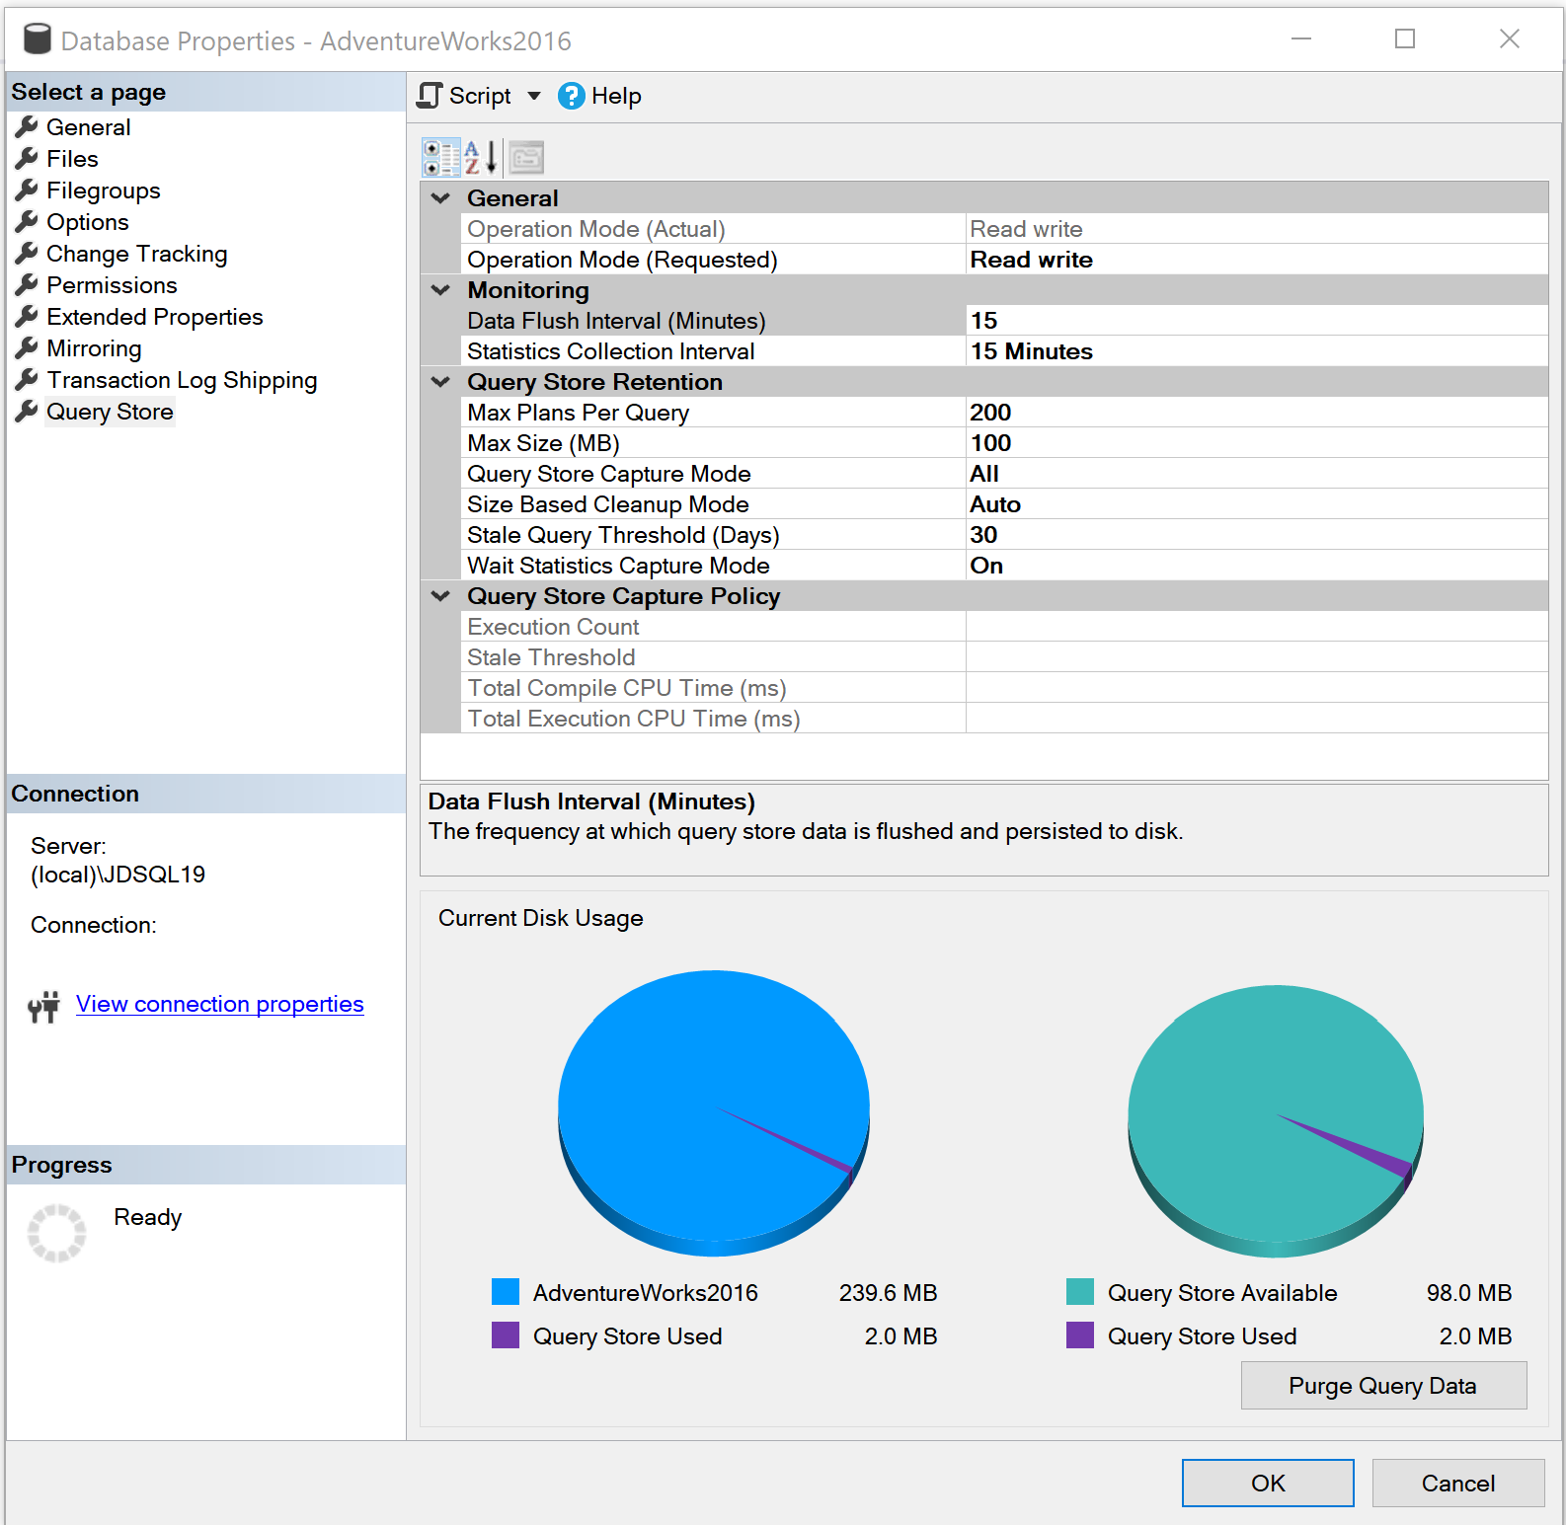
Introducing the Query Store
Query Store is set at the database level
Cannot be used for Master or TempDB system databases but can be enabled for the Model and MSDB system databases.
The user database stores the data in internal tables that can be accessed by using built-in Query Store views.
SQL Server retains this data until the space allocated to Query Store is full or manually purged.
Notes:
Please consider editing or deleting “Give me the top queries that have changed in performance compared to the number of executions. “

Slide 52
Why use Query Store?
Before Query Store
Requires manual proactive monitoring to identify execution plan problems.
Only the latest plan was stored in the procedure cache
Restart caused data to be lost
No history or aggregated gathering of data available.
Frequent recompiles of procedures or use of DBCC FREEPROCACHE
It works across server restarts, upgrades, and query recompilation
With Query Store
It stores the history of the execution plans for each query
It establishes a performance baseline for each plan over time
It identifies queries that may have regressed
It is possible to force plans quickly and easily
Notes:
Parameter-sensitive? GLOBAL query
GLOBAL: Do not capitalize generic terms. Please note that we do not capitalize terms unless they are from the UI or are feature or product names. Please consider lowercasing such terms throughout this document.
GLOBAL: Please avoid using first person (“we”, “I”) Always use “you” or “Microsoft” if that is applicable.
…have a lot of …?

Slide 53
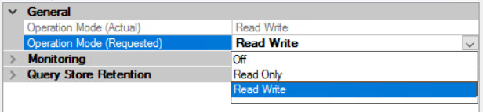

Query Store Operation Modes
Operation Mode can be set under database properties
Operation Mode can be enabled two ways using T-SQL. If only using the ON option, the Mode defaults to Read_Write

Slide 54
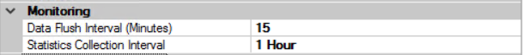
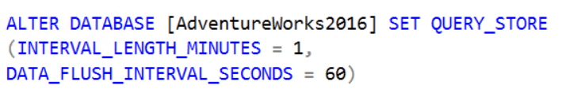
Query Store Monitoring Settings
Data Flush Interval determines the frequency at which data written to the query store is persisted to disk. (Default is 15 Minutes).

Slide 55
Query Store Monitoring Settings
Statistics Collection Interval determines the time interval at which runtime execution statistics data is aggregated into the query store. Only the values of 1, 5, 10, 15, 60, and 1440 minutes is allowed. (Default is 60).

Slide 56
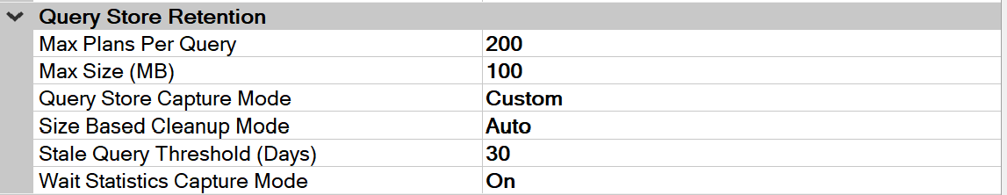
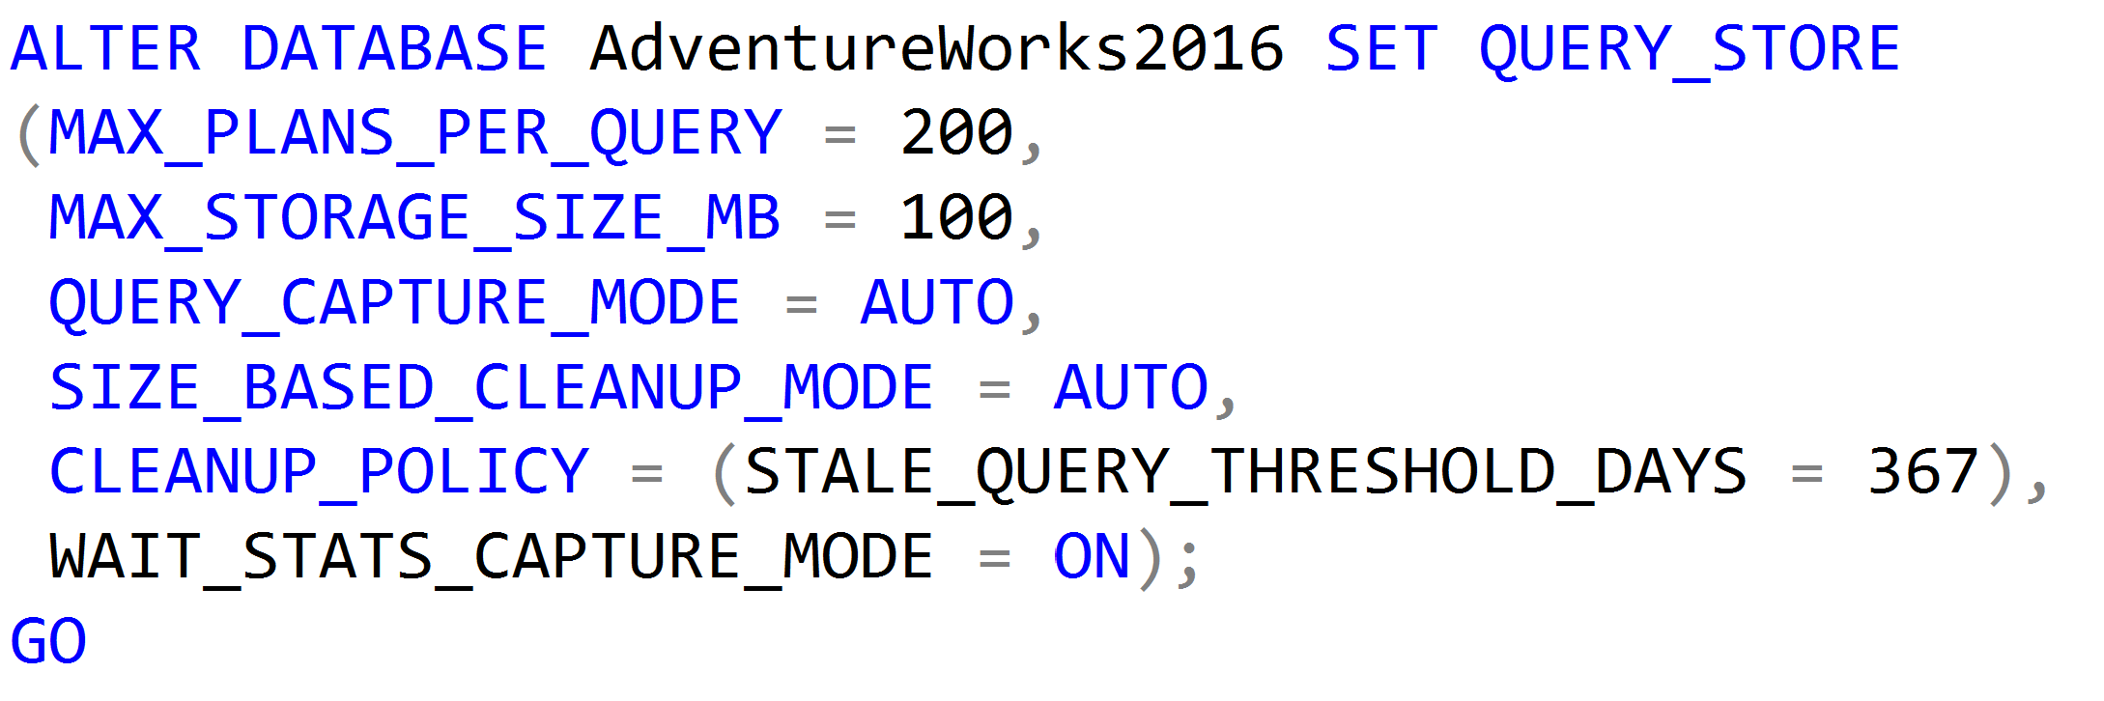
Query Store Retention Settings
Max Plans Per Query is a new retention setting introduced in SQL Server 2017 and is an integer representing the maximum number of plans maintained for each query. (Default is 200).

Slide 57
Query Store Retention Settings
Max Size (MB) configures the maximum storage size for the query store. (Default is 100MB) When the query store limit is reached, query store changes the state from read-write to read-only.

Slide 58
Query Store Retention Settings
Query Store Capture Mode determines to capture all the queries (Default is ALL), or relevant queries based on execution count and resource consumption (AUTO) or stop capturing queries (NONE). SQL Server 2019 introduces an additional (CUSTOM) setting.

Slide 59
Query Store Retention Settings
Size Based Cleanup Mode determines whether the cleanup process will be automatically activated when the total amount of data gets close to the maximum size. (Default is Auto).

Slide 60
Query Store Retention Settings
Stale Query Threshold (Days) determines the number of days to retain data in the query store. (Default is 30 days and Maximum is 367 days).

Slide 61
Query Store Retention Settings
Wait Statistics Capture Mode is a new retention setting introduced in SQL Server 2017 that controls if Query Store captures wait statistics information.
(Default = ON).

Slide 62
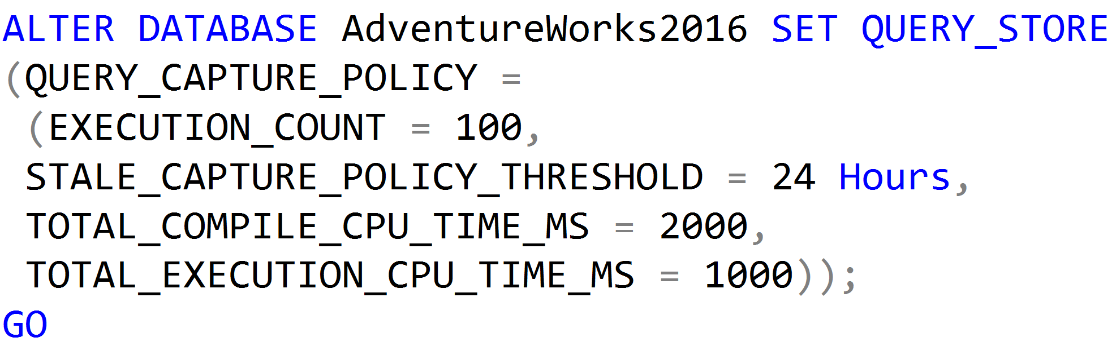
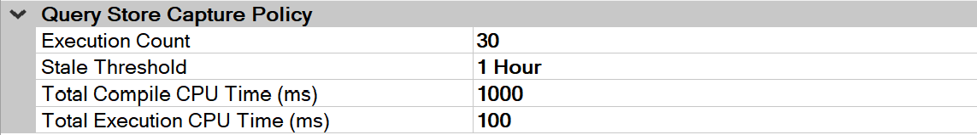
Query Store Capture Policy Settings
Introduced in SQL Server 2019 and available if the Query Store Capture Mode setting has been set to CUSTOM.
The value for the EXECUTION COUNT is the value a query must exceed within the Stale Threshold time period to be captured by the Query Store.

Slide 63
Query Store Capture Policy Settings
Introduced in SQL Server 2019 and available if the Query Store Capture Mode setting has been set to CUSTOM.
The value for the Stale Threshold can be from 1 hour up to 7 days. This setting specifies the time given to exceed the values of the three other settings for a query to be captured.

Slide 64
Query Store Capture Policy Settings
Introduced in SQL Server 2019 and available if the Query Store Capture Mode setting has been set to CUSTOM.
The value for the Total Compile CPU Time (ms) is the value in milliseconds that a query must exceed within the Stale Threshold time period to be captured by the Query Store.

Slide 65
Query Store Capture Policy Settings
Introduced in SQL Server 2019 and available if the Query Store Capture Mode setting has been set to CUSTOM.
The value for the Total Execution CPU Time (ms) is the value in milliseconds that a query must exceed within the Stale Threshold time period to be captured by the Query Store.

Slide 66
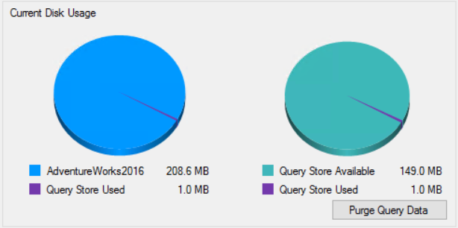
Purge Query Data
Data can be manually purged from the Query Store.

Slide 67
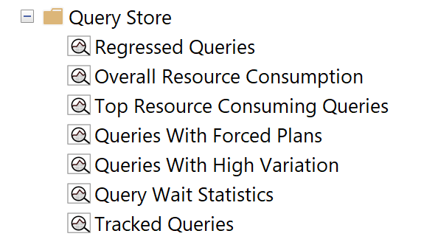
Query Store Reports
Regressed Queries: Use this dashboard to review queries that might have regressed because of execution plan changes
Notes:
Parameter-sensitive? GLOBAL query
GLOBAL: Do not capitalize generic terms. Please note that we do not capitalize terms unless they are from the UI or are feature or product names. Please consider lowercasing such terms throughout this document.
GLOBAL: Please avoid using first person (“we”, “I”) Always use “you” or “Microsoft” if that is applicable.
…have a lot of …?

Slide 68
Query Store Reports
Overall Resource Consumption: Use this dashboard to visualize overall resource consumption during the last month in four charts: duration, execution count, CPU time, and logical reads
Notes:
Parameter-sensitive? GLOBAL query
GLOBAL: Do not capitalize generic terms. Please note that we do not capitalize terms unless they are from the UI or are feature or product names. Please consider lowercasing such terms throughout this document.
GLOBAL: Please avoid using first person (“we”, “I”) Always use “you” or “Microsoft” if that is applicable.
…have a lot of …?

Slide 69
Query Store Reports
Top Resource Consuming Queries: Use this dashboard to review queries in the set of top 25 resource consumers during the last hour
Notes:
Parameter-sensitive? GLOBAL query
GLOBAL: Do not capitalize generic terms. Please note that we do not capitalize terms unless they are from the UI or are feature or product names. Please consider lowercasing such terms throughout this document.
GLOBAL: Please avoid using first person (“we”, “I”) Always use “you” or “Microsoft” if that is applicable.
…have a lot of …?

Slide 70
Query Store Reports
Queries With Forced Plans: Used to isolate queries that have been given a forced plan. Requires SQL Server 2016 SP1 or later.
Notes:
Parameter-sensitive? GLOBAL query
GLOBAL: Do not capitalize generic terms. Please note that we do not capitalize terms unless they are from the UI or are feature or product names. Please consider lowercasing such terms throughout this document.
GLOBAL: Please avoid using first person (“we”, “I”) Always use “you” or “Microsoft” if that is applicable.
…have a lot of …?

Slide 71
Query Store Reports
Queries With High Variation: Used to locate queries with high variation in query execution. Useful to locate queries with parameterization problems. Requires SQL Server 2016 SP1 or later.
Notes:
Parameter-sensitive? GLOBAL query
GLOBAL: Do not capitalize generic terms. Please note that we do not capitalize terms unless they are from the UI or are feature or product names. Please consider lowercasing such terms throughout this document.
GLOBAL: Please avoid using first person (“we”, “I”) Always use “you” or “Microsoft” if that is applicable.
…have a lot of …?

Slide 72
Query Store Reports
Query Wait Statistics shows a bar chart containing the top wait categories in the Query Store. Use the drop down at the top to select an aggregate criteria for the wait time: avg, max, min, std dev, and total (default). Requires SQL Server 2017.
Notes:
Parameter-sensitive? GLOBAL query
GLOBAL: Do not capitalize generic terms. Please note that we do not capitalize terms unless they are from the UI or are feature or product names. Please consider lowercasing such terms throughout this document.
GLOBAL: Please avoid using first person (“we”, “I”) Always use “you” or “Microsoft” if that is applicable.
…have a lot of …?

Slide 73
Query Store Reports
Tracked Queries: Use this dashboard to monitor the execution plans and regression of a specify query
Notes:
Parameter-sensitive? GLOBAL query
GLOBAL: Do not capitalize generic terms. Please note that we do not capitalize terms unless they are from the UI or are feature or product names. Please consider lowercasing such terms throughout this document.
GLOBAL: Please avoid using first person (“we”, “I”) Always use “you” or “Microsoft” if that is applicable.
…have a lot of …?

Slide 74
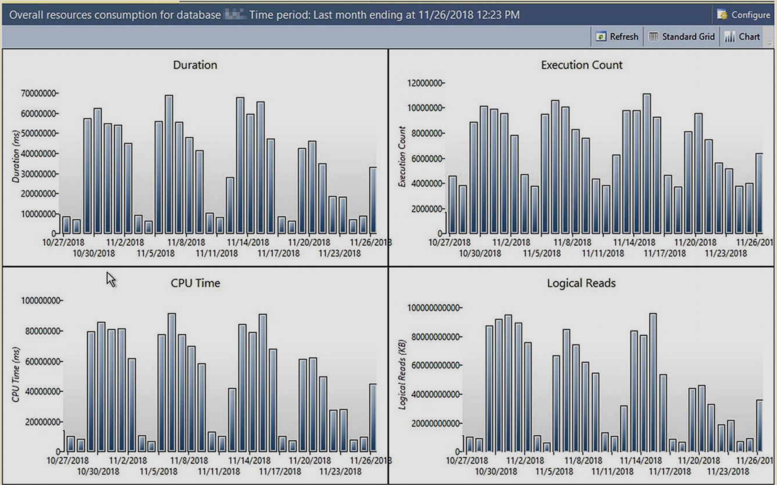
Establishing a Baseline
Notes:
Picture provide by Tracy Boggiano from her book Query Store for SQL Server 2019.
GLOBAL: Please avoid using first person (“we”, “I”) Always use “you” or “Microsoft” if that is applicable.

Slide 75
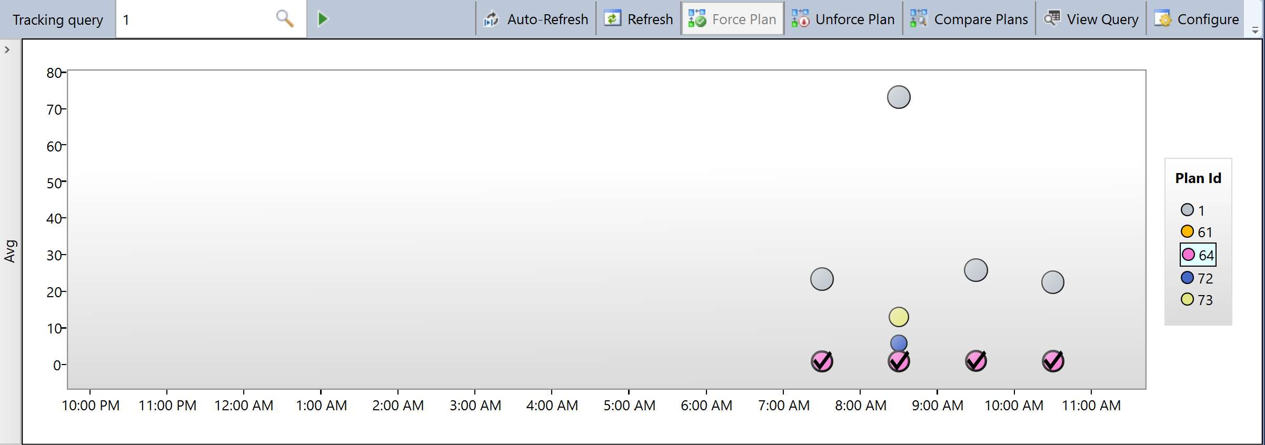
Force Plan
Notes:
GLOBAL: Please avoid using first person (“we”, “I”) Always use “you” or “Microsoft” if that is applicable.

Slide 76
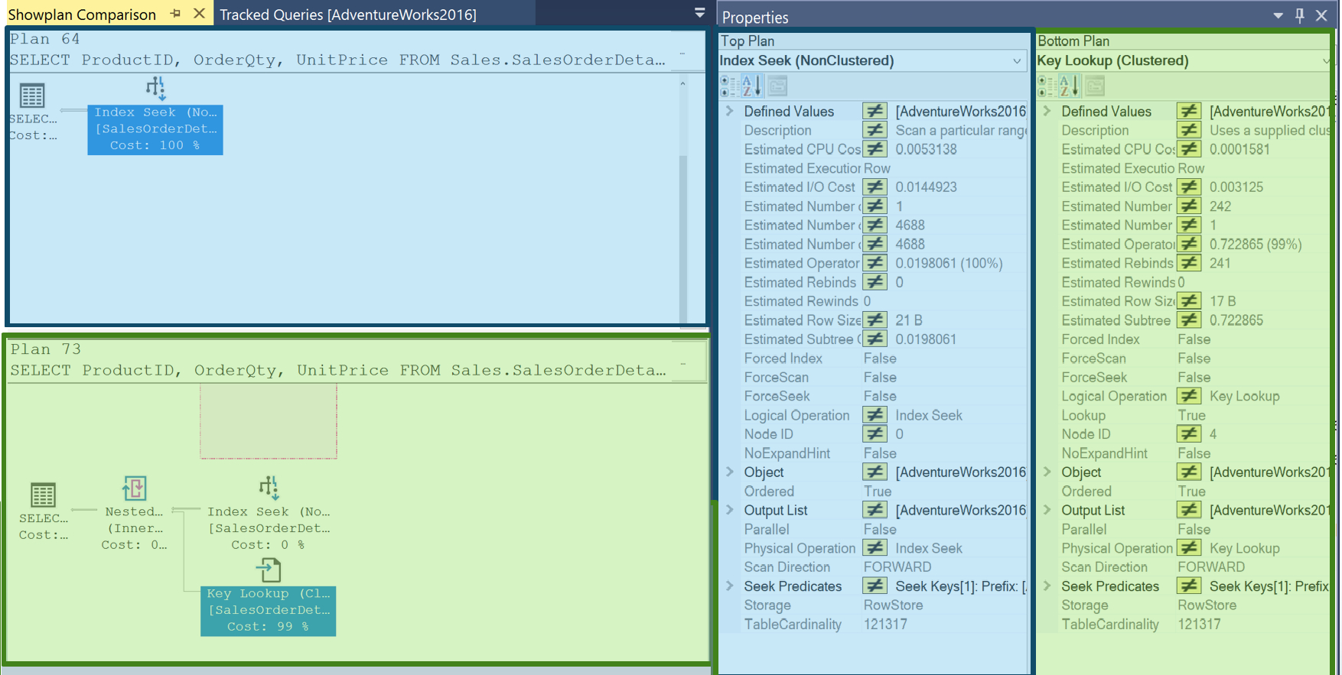
Plan Compare
Notes:
What version does “Before” refer to?
“query store compare plans was a complicated ” is unclear – please revisit.

Slide 77
Query Store Catalog Views
sys.query_store_query_text
 | query_text_id
 | query_sql_text
sys.query_store_query
 | query_id
 | query_text_id
 | context_settings_id
sys.query_store_plan
 | plan_id
 | query__id
sys.query_context_settings
 | context_settings_id
sys.query_store_wait_stats
 | waits_stats_id
 | plan_id
 | runtime_stats_interval_id
sys.query_store_runtime_stats
 | plan_id
 | runtime_stats_interval_id
Query Store Information
sys.query_store_runtime_stats_interval
 | runtime_stats_interval_id
 | start_time
 | End_time
Compile Time Information

Slide 78
Using Query Store Catalog Views
Finding the TOP 10 most frequently executed SQL Server Queries in the Query Store.
SELECT TOP 10 t.query_sql_text, q.query_id
FROM sys.query_store_query_text as t
JOIN sys.query_store_query as q
ON t.query_text_id = q.query_text_id
JOIN sys.query_store_plan as p
ON q.query_id = p.query_id
JOIN sys.query_store_runtime_stats as rs
ON p.plan_id = rs.plan_id
WHERE rs.count_executions >1
GROUP BY t.query_sql_text, q.query_id
ORDER BY SUM(rs.count_executions)

